Slide 1


Slide 2
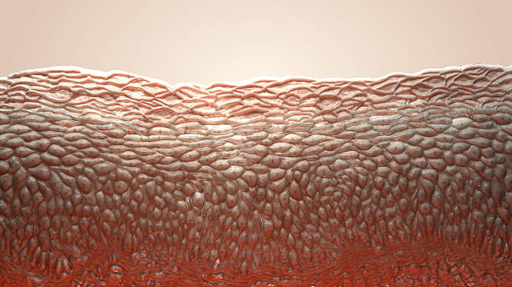
CHAPTER 3: TISSUES
Course title: Anatomy and Histology Lecture# 2
Ms. Aisha Akhter
Lecturer
Faculty of Pharmacy
JINNAH UNIVERSITY FOR WOMEN

Slide 3
Lecture Objectives
By the end of this lecture, you will be able to understand following points.
Introduction to Connective tissues
Components of Connective Tissue
Different Types of Connective Tissue with their location and functions

Slide 4
Connective Tissue
3 TYPES
Connective tissue proper
Supporting connective tissue
Fluid connective tissue

Slide 5
CONNECTIVE TISSUE
Connective tissue is one of the basic tissues which gives structural and metabolic support to the organ and other tissues of the body.
It connects or bind other type of tissues.
It consists of cells surrounded by a compartment of fluid called the extracellular matrix (ECM).

Slide 6
CONNECTIVE TISSUE
GENERAL FEATURES (Component of C.T.)
Connective tissue consists of three main components: cells, protein fibers, and ground substance. Together the fibers and ground substance make up the extracellular matrix
1. Cells
2. ExtraCellular Matrix (ECM)
-Fibers
-Ground substance

Slide 7
Functions
Support Structural & Mechanical (Bones)
Cushioning & Insulating Fills spaces, Shape to the organ (Adipose)
Storage Adipose tissue: energy
Loose areolar CT: water & Electrolytes
Transport Medium for Nutrients & Metabolic wastes(blood)
Repair Fibroblasts: matrix and fibres
Defense Cells: Phagocytosis or Antibodies
Protection cranium and sternum

Slide 8
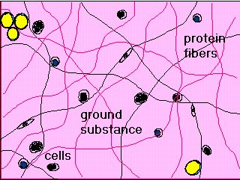
Connective Tissue

Slide 9
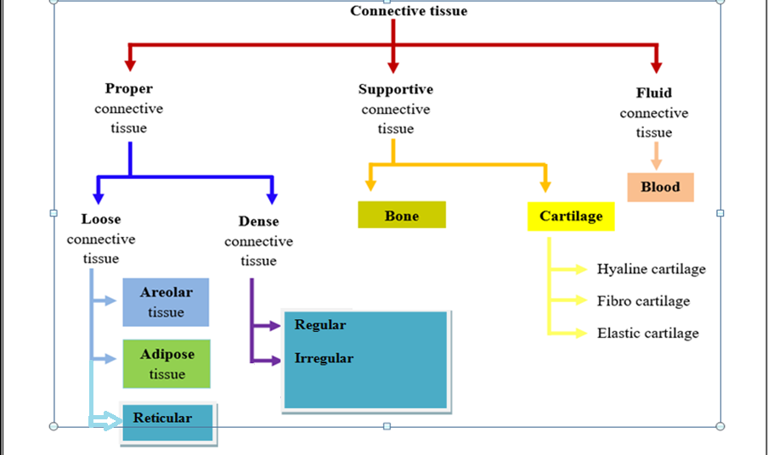
Classification of Connective Tissue

Slide 10
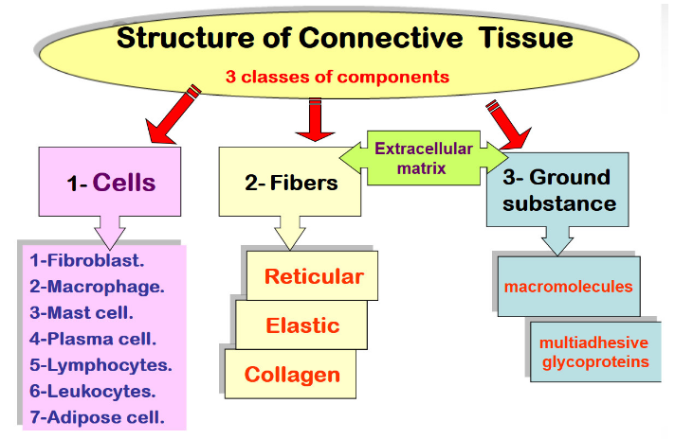
Components of Connective Tissue

Slide 11
Cells of Connective Tissue
Fibroblasts produce and maintain the extracellular matrix. They are the most common cell type in connective tissue.
Macrophages are phagocytic cells that engulf and digest microbes, cellular debris, and foreign substances
Mast cells release molecules that dilate blood vessels and recruit more immune cells to a site of mast cell activation
Plasma cells are mature B lymphocytes that produce large quantities of antibodies
Leucocytes granulocytes and agranulocytes that are involved in many inflammatory processes, including parasitic infections, allergic diseases, and asthma
Adipocytes: Adipocytes are energy storing cells that contain large globules of fat known as lipid droplets

Slide 12
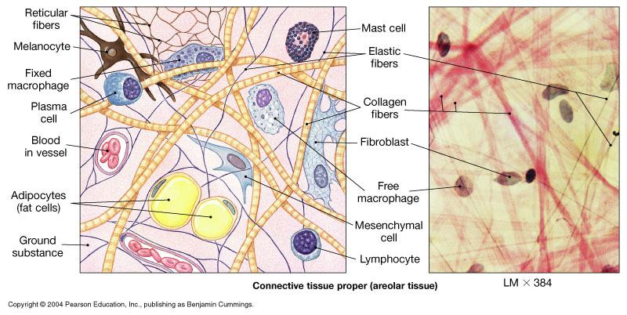
The Cells and Fibers of C.T.

Slide 13
Fibers
The three types of connective tissue fibers are:
Collagen fibers -(most abundant protein in the body) Tensile strength - resistance to stretching
Elastic fibers - contain elastin and fibrillin giving stretching and bending properties to tissues. They are mostly found within the walls of large blood vessels
Reticular fibers
Support - holds blood vessels to surface of organs
they are thin delicate fibers that form meshlike networks in organs such as the spleen, kidneys and lymph nodes

Slide 14
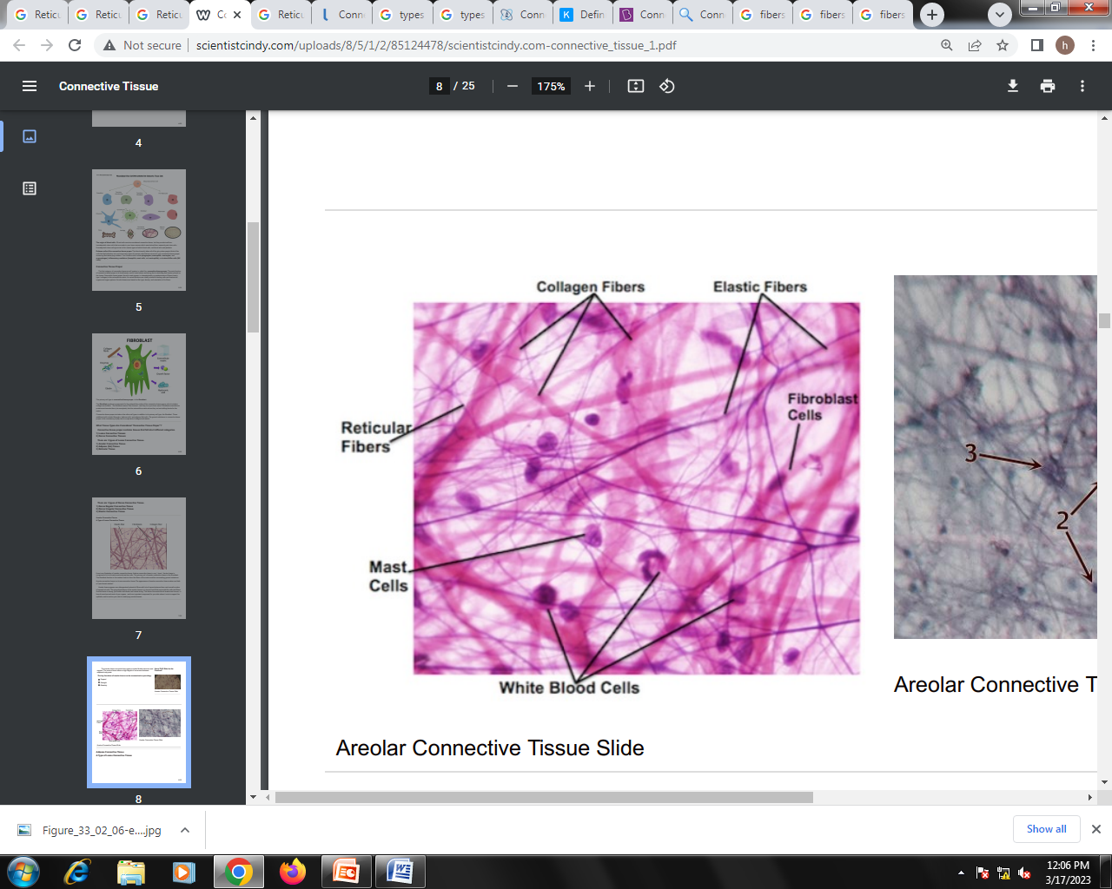
Connective Tissue Fibers

Slide 15
Ground substance
Ground substance is the background material within which all other connective tissue elements are embedded. In ordinary connective tissue, the ground substance consists mainly of water whose major role is to provide a route for communication and transport (by diffusion) between tissues.
Composition:
Glycosaminoglycans Hyaluronic Acid & Heparan Sulphate.
Glycoproteins Fibronectin(Dermis), Chondronectin(in Cartilage) & Laminin(in basement membrane)
Water & Electrolytes

Slide 16
Connective tissue proper

Slide 17
Connective Tissue Proper
These connective tissue types differ with respect to their numbers and types of cells and the relative properties and proportions of their fibers and ground substance.
Its main function is to bind cells and tissues and act as a kind of packing material between other tissues and organs.
It generally has higher protein fiber content
Two types of connective tissue
loose connective
dense connective

Slide 18
Loose connective tissue
Distributed throughout the body as a binding and packing material
Contains relatively fewer cells and protein fibers than dense connective tissue but has more ground substance.
Cells – fibroblasts and Matrix –composed of collagen and elastic fibers are loosely dispersed
It binds the skin to the underlying muscles and is highly vascular, providing nutrients to the skin.
There are three types of loose connective tissue:
areolar connective tissue
adipose connective tissue
reticular connective tissue

Slide 19
Loose Connective tissue
1.Areolar loose connective tissue
This type of loose connective tissue serves as the “filler” material for the body. The components of areolar loose connective tissue include:
Cells - fibroblasts (synthesize fibers of connective tissue)
Matrix - fluid with sparse collagen and elastin fibers forming a three-dimensional "web"
Location: Around blood vessels, nerves, skin and organs.
Function: Provides strength, elasticity, support and immune system protection
2.Adipose loose connective tissue
Cells - adipose cells (filled with oil droplets)
Matrix -fluid with sparse reticular and collagen fibers
Function: Store energy, provide protection, and insulate.
Location: Around organs, subcutaneous layer(between skin and muscle)

Slide 20
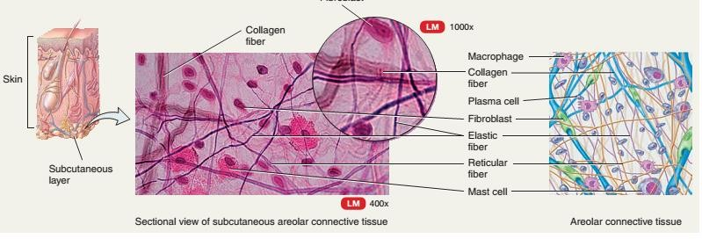

Slide 21
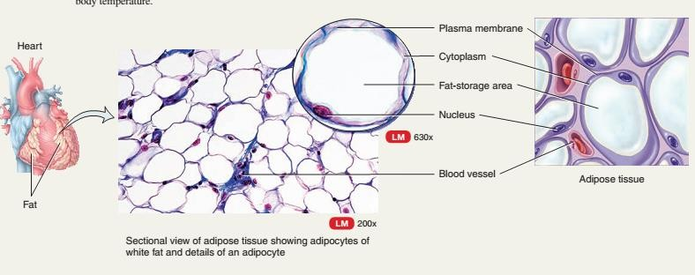

Slide 22
3. Reticular loose connective tissue
Cells - reticular cells
Matrix - fluid with loosely packed reticular fibers
Location: Around organs such as the liver, kidney, spleen, and lymph organs.
Function: supporting framework for haemopoietic organs

Slide 23
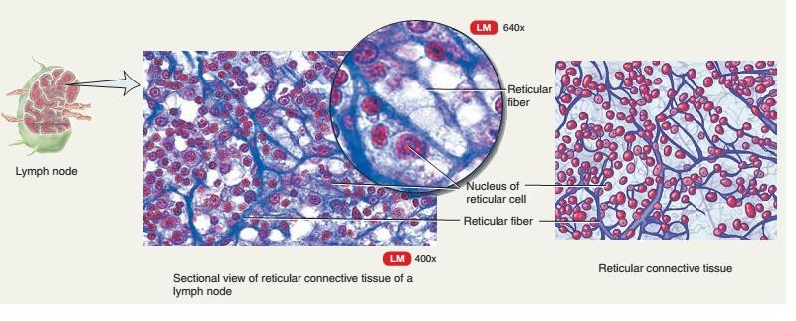

Slide 24
Dense Connective tissue proper (CTP):
Dense Regular CTP
Dense Irregular CTP
Cells - fibroblasts
Matrix – composed of dense collagen fibers
Fibers are predominant elements

Slide 25
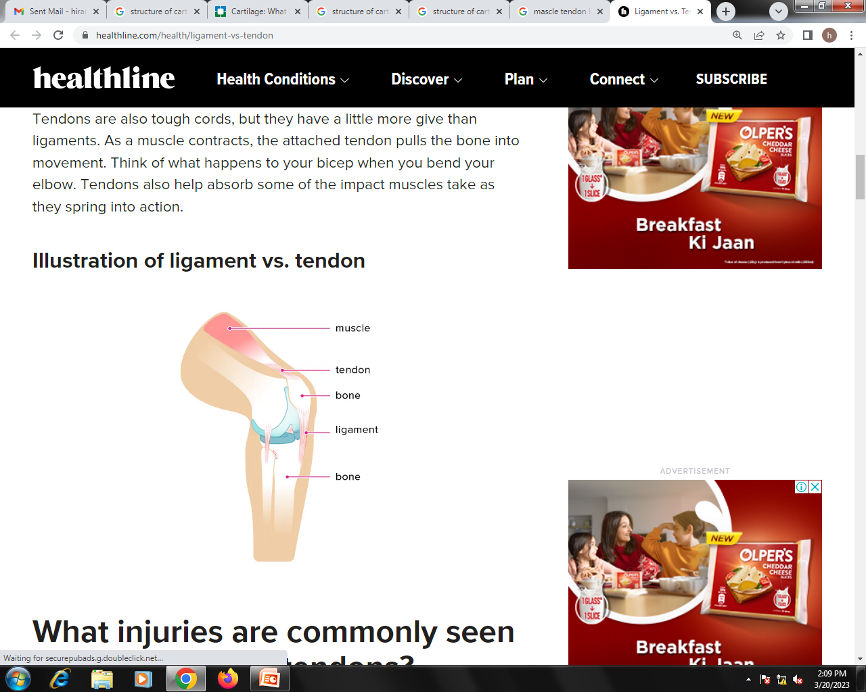
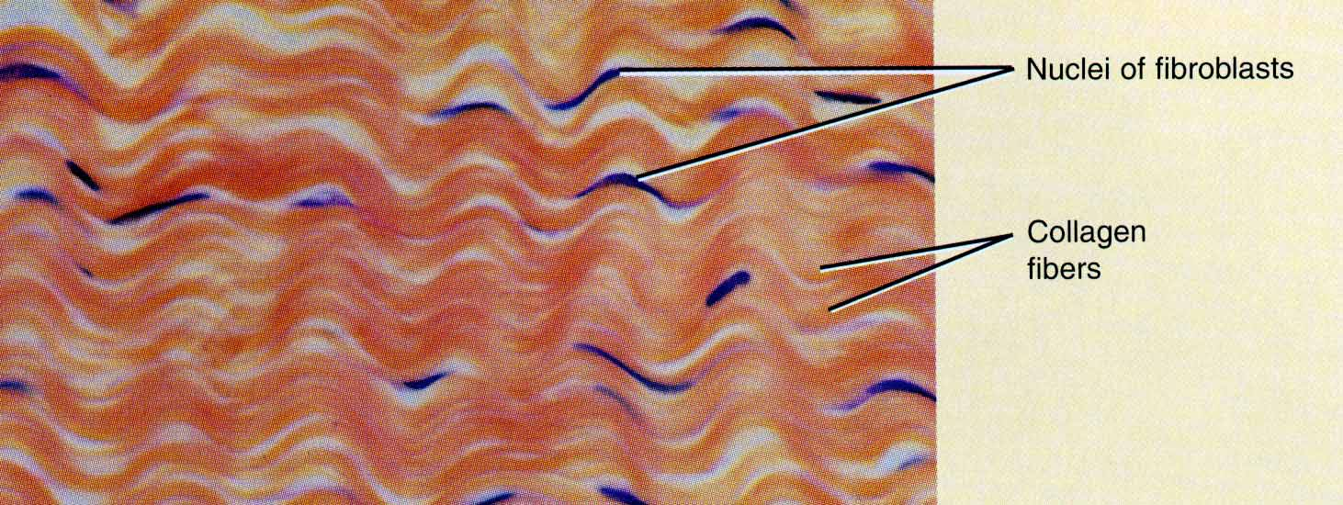
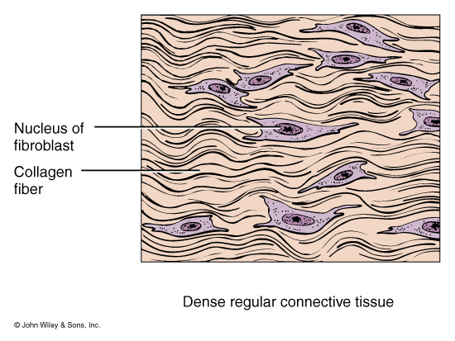
Dense Regular Connective Tissue
Collagen fibers form parallel bundles
Cells: fibrocytes
Matrix: dense Collagen Fiber
Give Tensile strength in one direction
e.g: Tendons, Ligaments
Functions - tendons (connect muscle to bone)
and ligaments (connect bones together and
hold organs in one position)

Slide 26
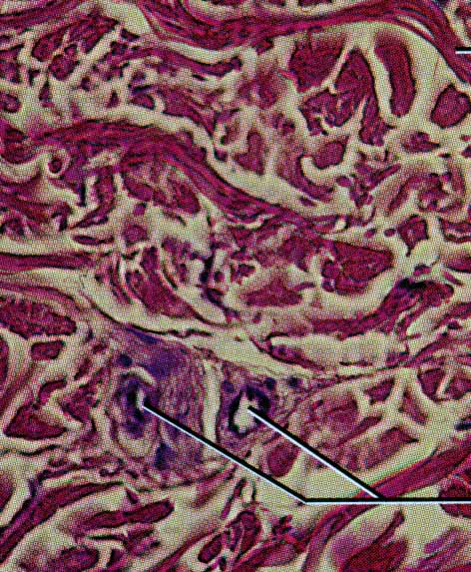
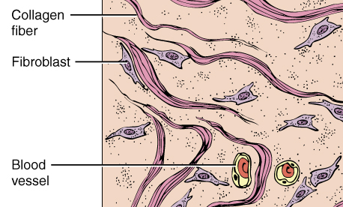
Dense Irregular Connective Tissue
Fibrocyte
Collagen fibers are irregularly arranged
Tissue can resist tension from any direction
e.g: Very tough tissue -- dermis of skin and Organ Capsule

Slide 27
Supporting connective tissue
The supporting connective tissue have a strong and durable framework that protects and supports the soft body tissues.
The extracellular matrix in supporting connective tissue contains many protein fibers and a ground substance that ranges from semisolid to solid.
Bones and cartilage are supporting connective tissue. The cartilage has a semisolid (gel) extracellular matrix, while bone has a solid extracellular matrix.

Slide 28
Supportive connective tissue: Cartilage and Bone
They are supporting tissue that protect vital organs
Types-
Cartilage:
Hyaline cartilage,
elastic cartilage
fibrous cartilage
Bone:
spongy bone
compact bone

Slide 29
Supporting connective tissue
CARTILAGE
Cartilage is strong and resilient among different connective tissue types, and it provides flexible support
Made up of
Chondrocytes
Chondroitin sulfate + Proteoglycans
Collagen fibers + elastin fibers
The chondrocytes that occupy small spaces in extracellular matrix called lacunae.
The chondroitin sulfate with other substances of ground substance gives it flexibility and resilience.
The collagen fibers give it strength.

Slide 30
Supporting Connective Tissue: CARTILAGE
Hyaline – found between ribs and the sternum, along passageway of respiratory tract, opposing surfaces of bones with many joints (elbow and knee), tip of nose.
Elastic – outer ear, epiglottis
Fibrocartilage – between vertebrae, pubic bones of pelvis, some joints and tendons

Slide 31
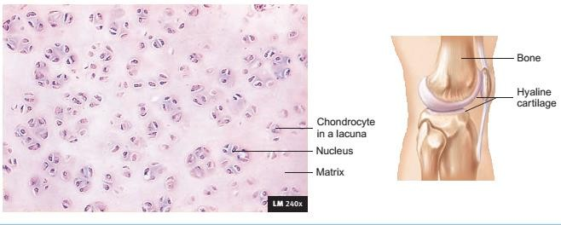
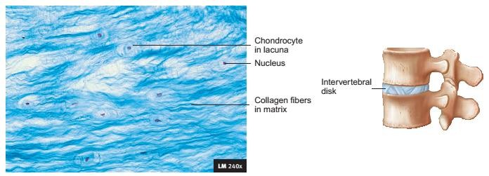
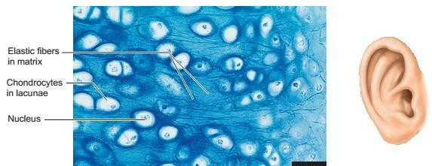
Hyaline Cartilage
Fibrocartilage
Elastic Cartilage

Slide 32

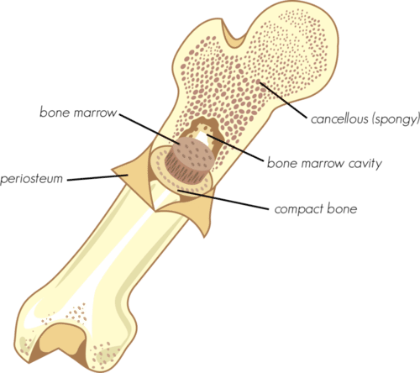
BONE
Bone is a hard connective tissue that consists of living cells and a mineralized matrix.
The strength and rigidity of the mineralized matrix enable bones to support and protect other tissues and organs of the body.
There are three types of cells that contribute to bone homeostasis.
Osteoblasts are bone-forming cell,
osteoclasts resorb or break down bone,
osteocytes are mature bone cells
An equilibrium between osteoblasts and osteoclasts maintains bone tissue.

Slide 33
All bones (except surfaces of joints of long bones) are covered by dense irregular connective tissue called periosteum. Periosteum serve as a site for attachment of ligaments and tendons.
Bone has rich vascular supply and is site for active metabolic activity.
Bone serves many functions including support, protection, storage(minerals, triglyceride), hemopoiesis
Classification:
Based on density and porosity two types of bone connective tissue exists.
Compact bone
Spongy bone
Both bones are found in all bones of the body.
80% is compact bone 20% is spongy in all skeleton system.

Slide 34
Compact bone
Makes outer hard shell of the bone and has more matrix than spaces
The basic unit of compact bone is an osteon or haversian system. Each osteon has four parts
The lamellae ; concentric rings of extracellular matrix that consist of mineral salts (mostly calcium and phosphates). The lamellae are responsible for the compact nature of this type of bone tissue.
Lacunae ; small spaces between lamellae that contain mature bone cells called osteocytes.
Canaliculi : networks of minute canals that project from lacunae containing the processes of osteocytes. Canaliculi provide routes for nutrients to reach osteocytes and for wastes to leave them.
A central (haversian) canal contains blood vessels and nerves.
The osteon runs parallel to the shaft of long bones

Slide 35
Spongy bone
Located in the interior of the bone.
Contain more space than matrix
Instead of being completely solid, spongy bone contains spaces, and the bone connective tissue forms a latticework structure called trabeculae which contain lamellae,osteocytes, lacunae, canaliculi.
Spaces between trabeculae are filled with red bone marrow which is site for hemopoiesis
Although lighter than compact bone, spongy bone is still designed for strength. Like braces used for support in buildings, the solid portions of spongy bone follow lines of stress

Slide 36
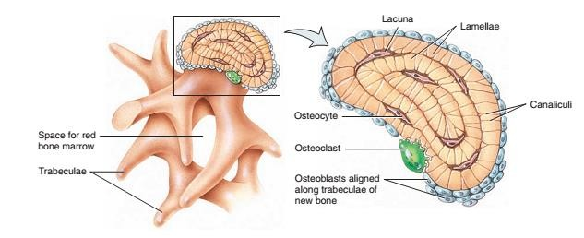
Histology of Spongy Bone

Slide 37
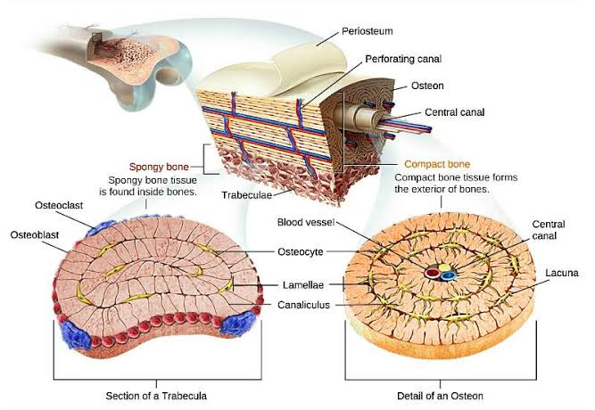
Histology of Bone

Slide 38
Fluid connective tissue
Blood
Blood is a fluid connective tissue that travels through tubular vessels.
Blood consists of cells and cell fragments collectively called formed elements. These formed elements are erythrocytes, leukocytes(white blood cells), and platelets.
contains dissolved protein fibers in a watery ground substance. Together, the dissolved protein fibers and the watery ground substance form an extracellular matrix called plasma.
Blood cells
Plasma.
RBC, WBC, PLATLETS.

Slide 39
Plasma
Blood plasma is a complex mixture of water, proteins, and other solutes
Water is the most abundant compound in plasma, making up about 92% of plasma’s total volume
The next most abundant compounds in plasma are the plasma proteins which makes 7% of the plasma include
albumins
globulins
Fibrinogen
regulatory proteins
Albumins are the smallest and most abundant of the plasma proteins, making up approximately 58% of total plasma proteins. They regulate water movement between the blood and interstitial fluid and also help in transport.

Slide 40
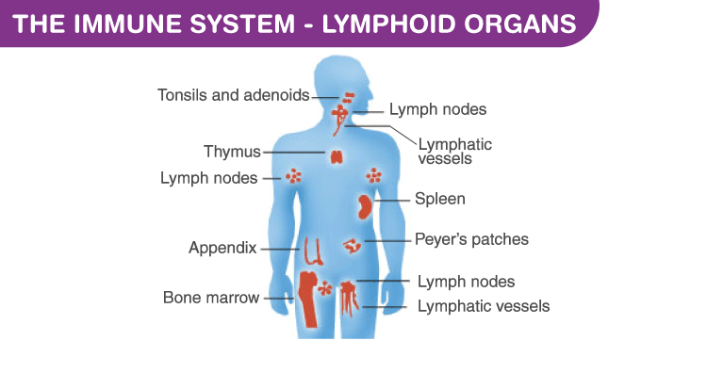
Fluid Connective Tissue, LYMPH
Lymph is usually a clear, colorless fluid, similar to blood plasma but low in protein. Its composition varies substantially from place to place. After a meal, for example, lymph draining from the small intestine has a milky appearance because of its high lipid content.
Lymph leaving the lymph nodes contains a large number of lymphocytes—indeed, this is the main supply of lymphocytes to the bloodstream

Slide 41
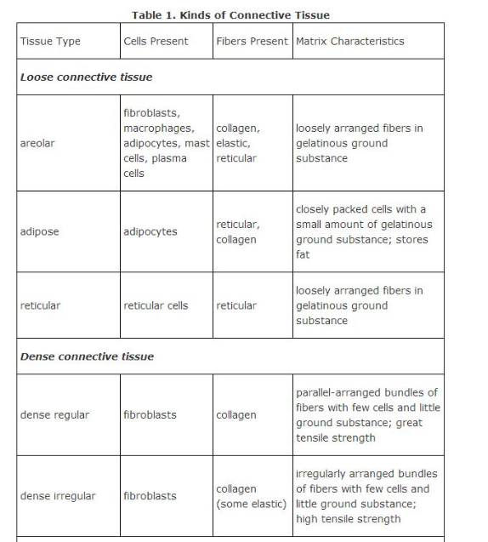

Slide 42
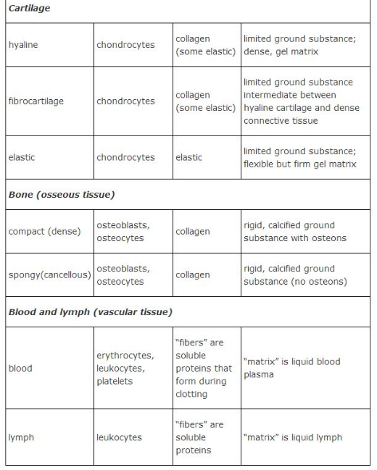

Slide 43
REFERENCES
Anatomy and Physiology - Ross and Wilson ( edition 12th,section 1, cell tissue and organization of body and page # 31 )
Tortora’s Principles of Anatomy and Physiology

